Slide 1
Project Proposal
Data Statistics SS 2022
Supervisor: Dr. Dinkelacker
Tutor: Ian ?
TRAs expression in Human Embryo Cells
Alina Aksianova, Letizia Holube, Nina Bank, Lydia Steiner

Slide 2
TRAs
Tissue Restricted Antigenes
Central tolerance of the immune system = Negative Selection process (Kyewski & Klein,2006)
Developing T-Cells -> exposed to TRAs in thymus -> binding cells apoptosis
Defect: Auto immune diseases, e.g. Diabetes Type I (Atkinson, Eisenbarth, Michels, 2014)
Application: Tumor Marker, Immunotherapy (Hong, 2014), (Mahmoud,2018)

Slide 3
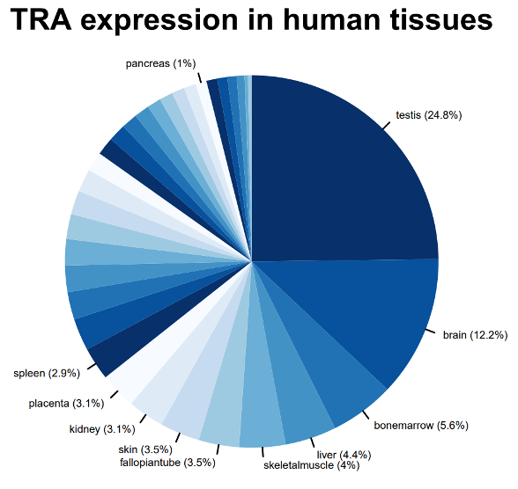
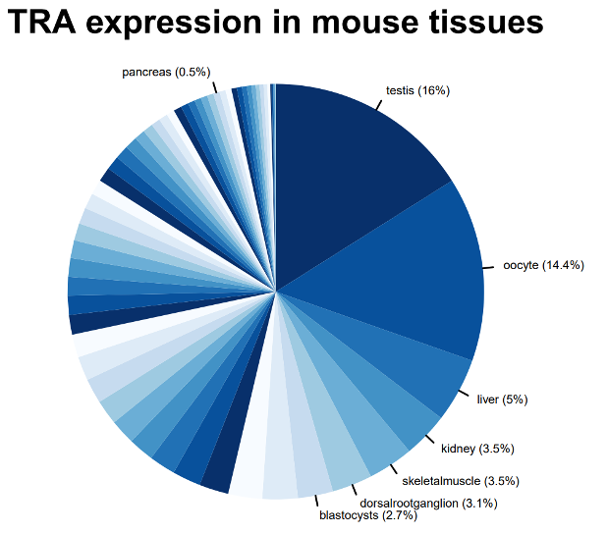
TRA-gene table
tra.2014.human.5x.table
ensembl.transcript | ensembl.gene | gene.symbol | entrezID | refseqID | unigeneID | chrom | startsite | tiss.number | tissues | max.tissue
ENST00000004103 | ENSG00000002933 | TMEM176A | 55365 | Hs.647116 | Hs.647116 | 7 | 150497491 | 2 | PB-CD14+Monocytes/Liver/kidney | Liver
Dinkelacker, 2007
Dinkelacker, 2019
Notes:
Datensatz kurz

Slide 4


Slide 5
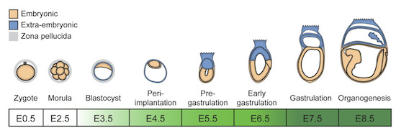
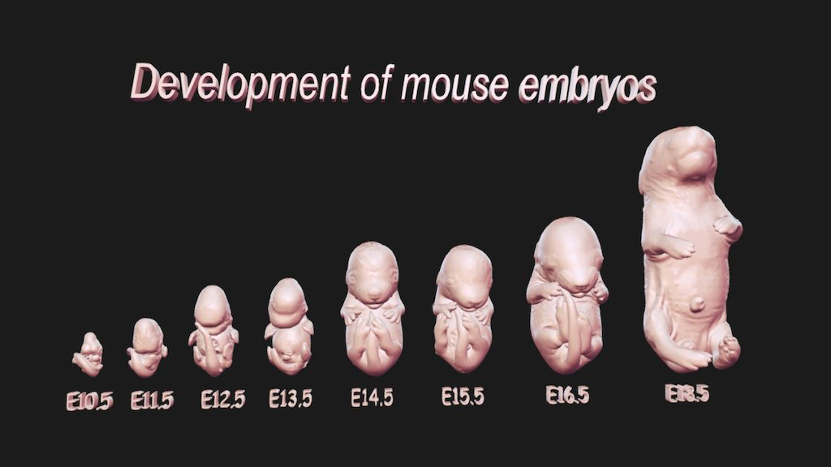
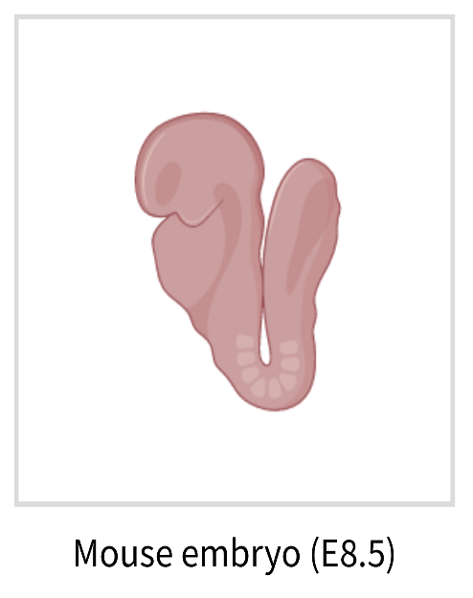
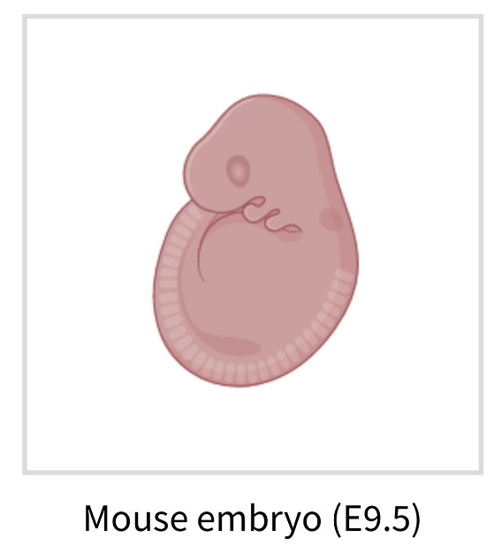
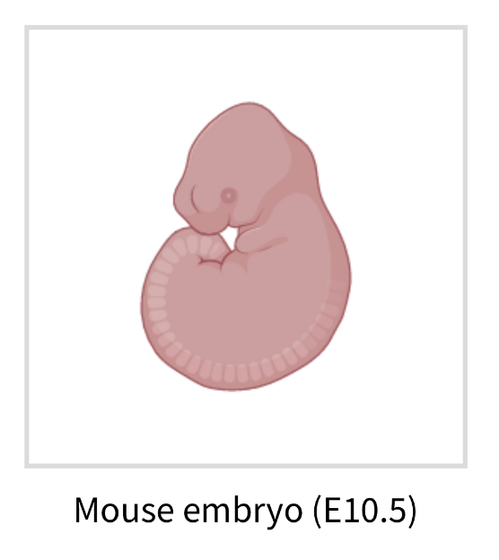
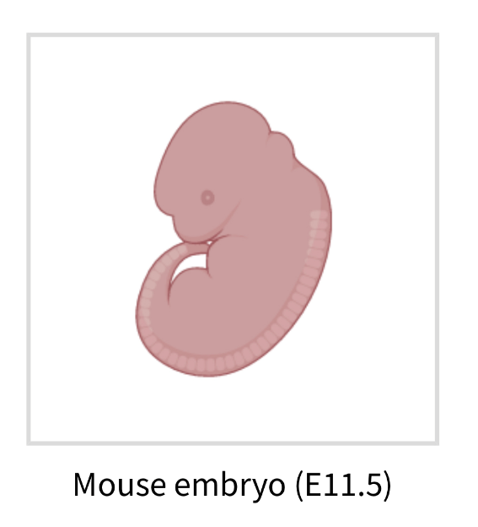
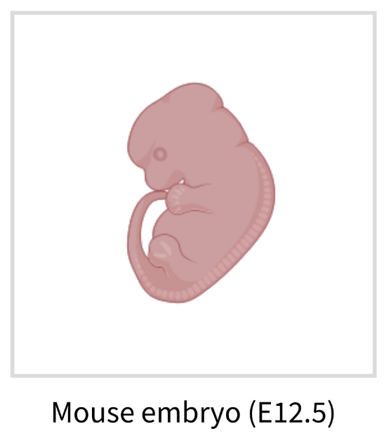
Dataset
What did we choose, why did we choose it
Irie, N., & Kuratani, S. (2011). Comparative transcriptome analysis reveals vertebrate phylotypic period during organogenesis. Nature communications, 2, 248. https://doi.org/10.1038/ncomms1248
Gene Expression in mouse embryo development
Intervals: E7.5, E8.5, E9.5, E10.5, E12.5, E14.5, E16.5, E18.5 (days after mating)
each containig 2-3 samples with RNA of multiple whole embyos
Notes:
Phylotypic stage: developmental period in mid-embryogenesis where related species within a phylum (Tierstamm), highest resemblance
Datensatz erklären können
-

Slide 6
Dataset
What did we choose, why did we choose it
Irie, N., & Kuratani, S. (2011). Comparative transcriptome analysis reveals vertebrate phylotypic period during organogenesis. Nature communications, 2, 248. https://doi.org/10.1038/ncomms1248
Gene Expression in mouse embryo development
Intervals: E7.5, E8.5, E9.5, E10.5, E12.5, E14.5, E16.5, E18.5 (days after mating)
each containig 2-3 samples with RNA of multiple whole embyos
Notes:
Phylotypic stage: developmental period in mid-embryogenesis where related species within a phylum (Tierstamm), highest resemblance
Datensatz erklären können
-

Slide 7
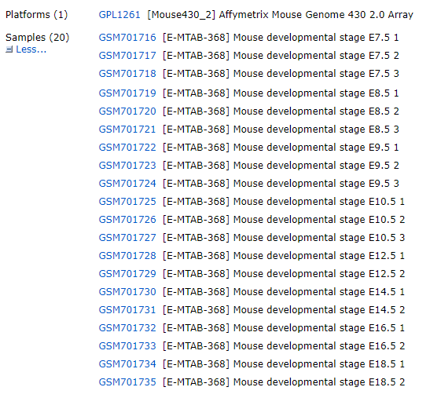
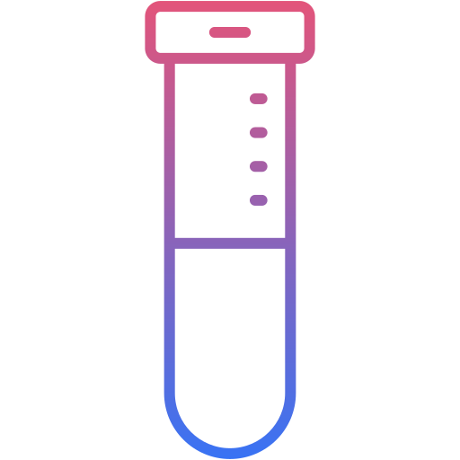
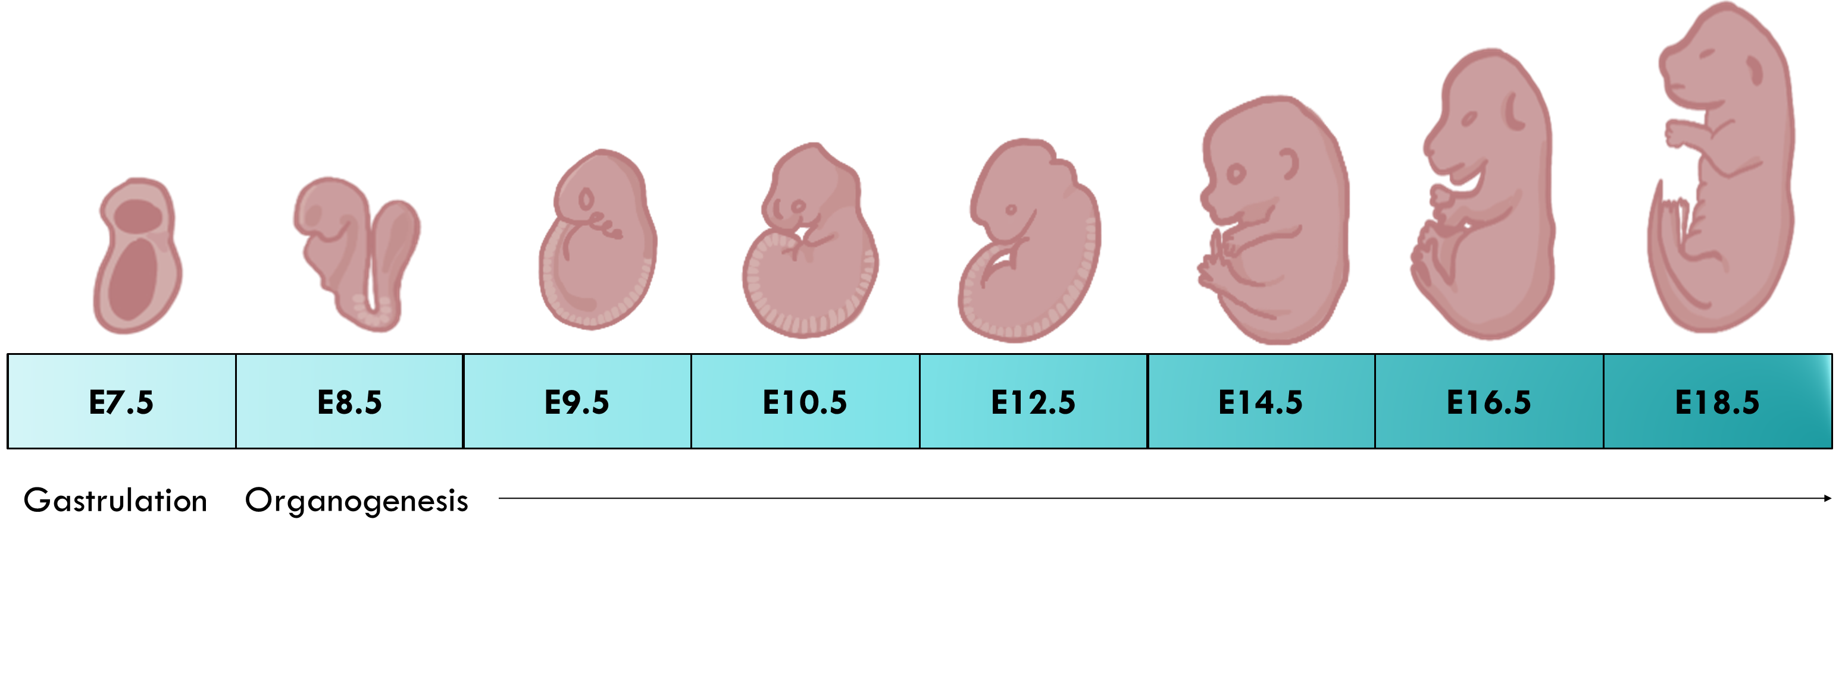
Dataset
3x
3x
3x
3x
2x
2x
2x
2x
E.7.5 Embrionic Day 7.5
Notes:
Each number represents an embryo from a differrent mouse. E.g. 3x E7.5 means three seperate pregnant mice were selected on the 7th day after mating and from each of the three mice, 1 embryo was extracted. (Thereby using three adult mice and three 7-day-old embryos)
As for the dataset, the research group looked at the gene Expression in mouse embryo development at 8 different stages: Embryonic Day 7.5, 8.5, 9.5, 10.5, 12.5, 14.5, 16.5 and 18.5, simply put at stages of early embryo development, middle embryo development and late embryo development, since a mouses pregnancy only lasts for 18-21 days. So, 7.5 refers to the 7th day after mating and 18.5 to the 18th day after mating, which should be close to the pup’s birth.

Slide 8
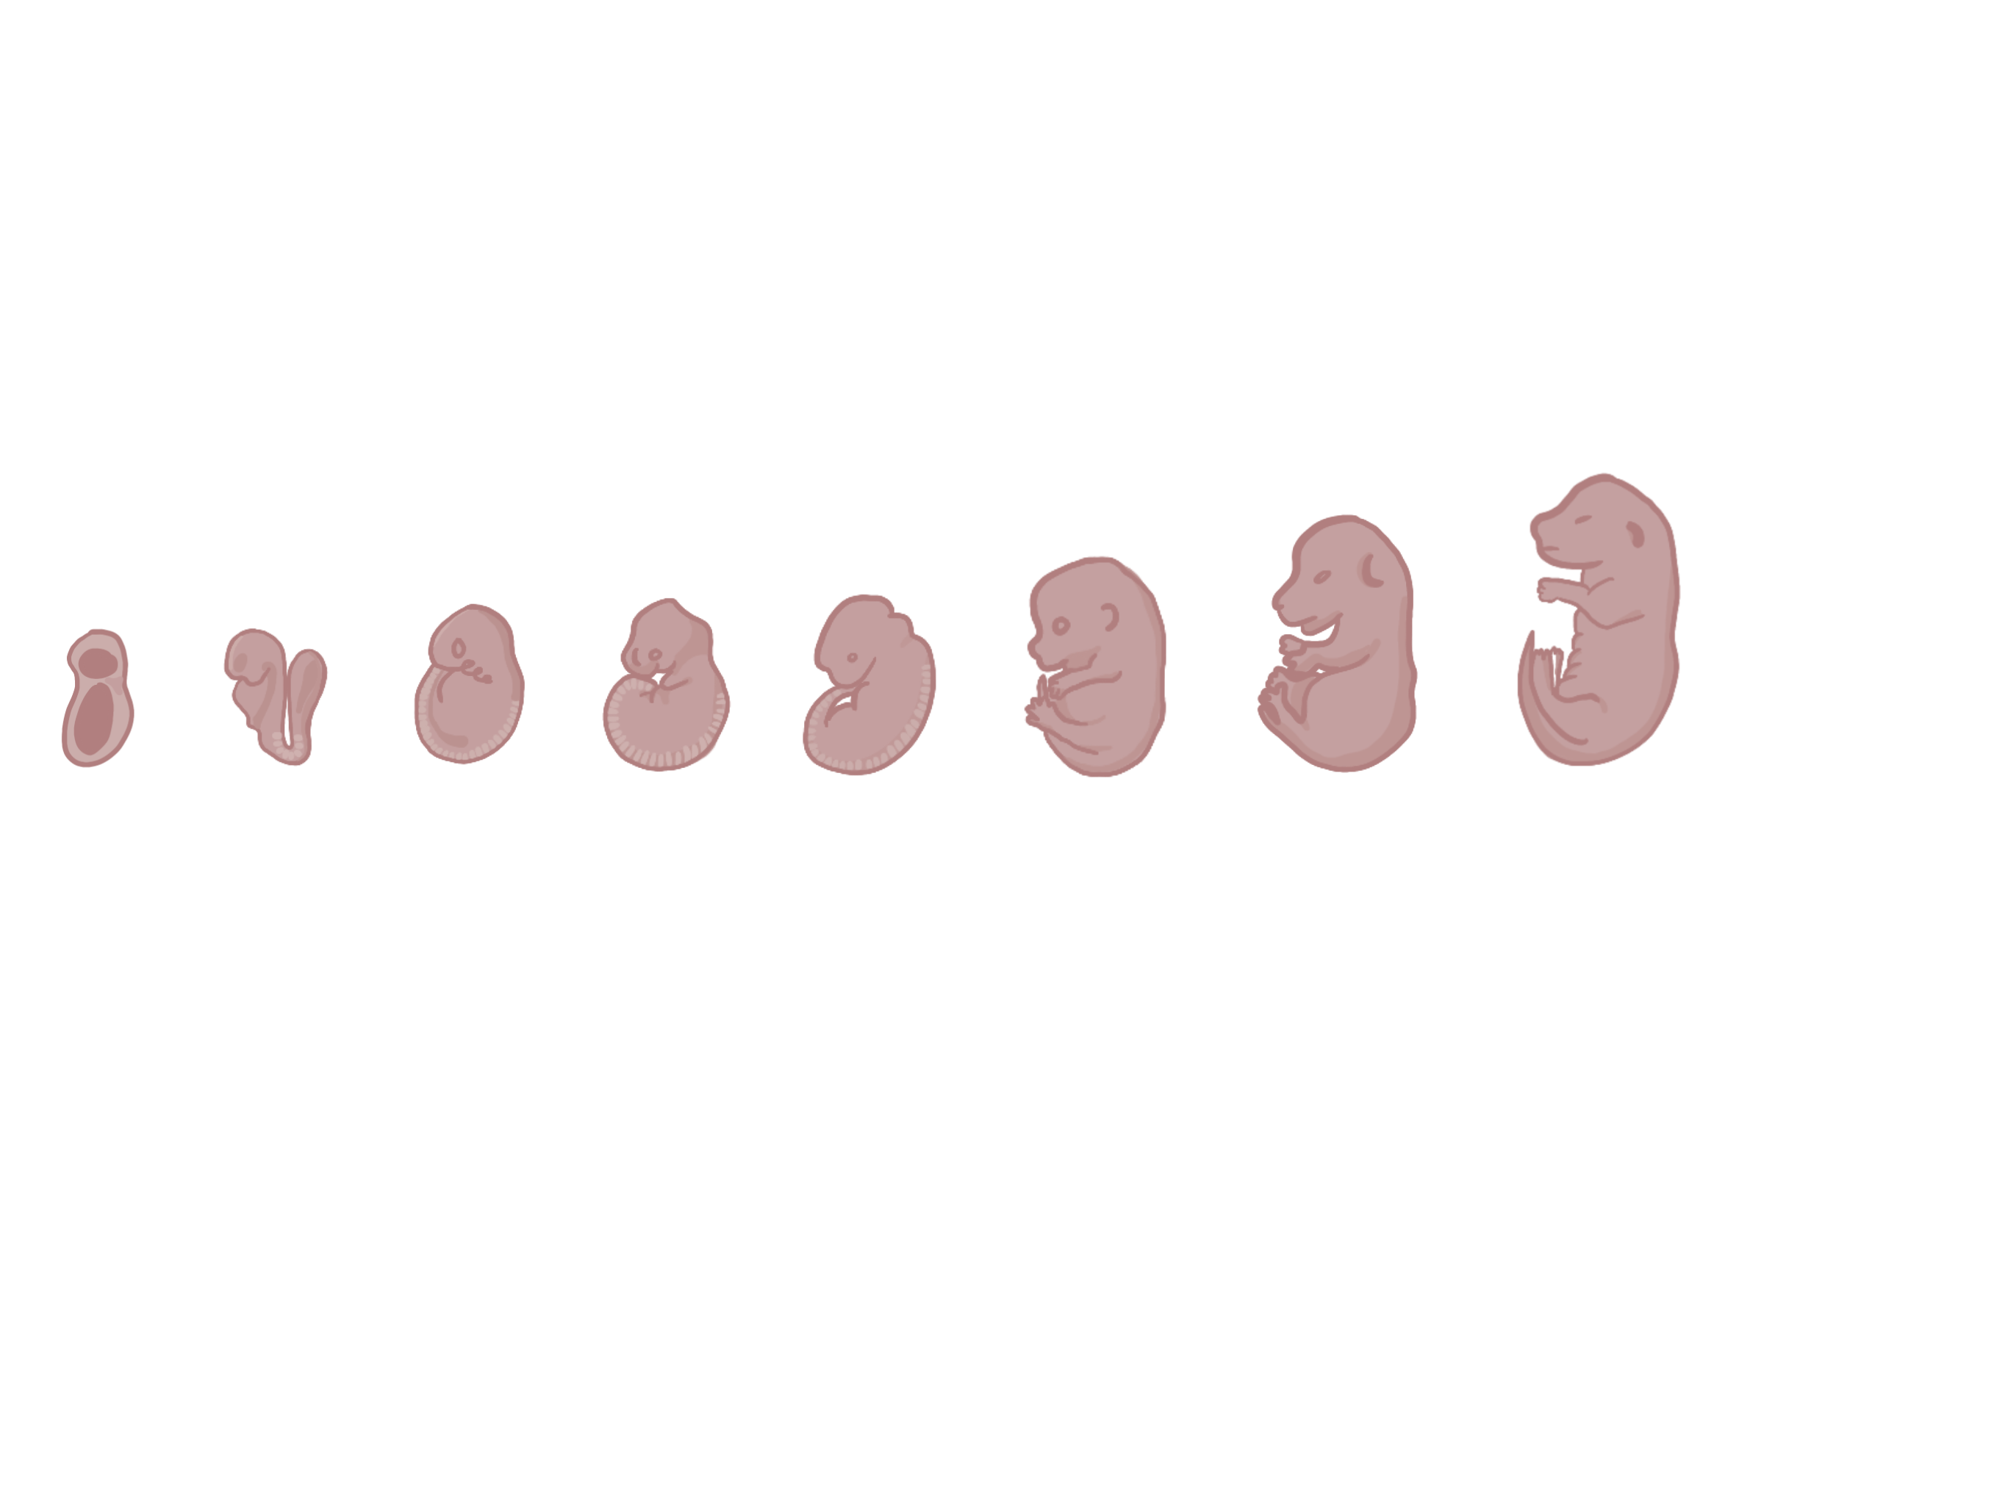
Dataset
E7.5
E8.5
E9.5
E10.5
E12.5
E14.5
E16.5
E18.5
Gastrulation
Organogenesis
E.7.5 Embrionic Day 7.5
Created with BioRender.com
Notes:
As for the dataset, the research group looked at the gene Expression in mouse embryo development at 8 different stages: Embryonic Day 7.5, 8.5, 9.5, 10.5, 12.5, 14.5, 16.5 and 18.5, simply put at stages of early embryo development, middle embryo development and late embryo development, since a mouses pregnancy only lasts for 18-21 days. So, 7.5 refers to the 7th day after mating and 18.5 to the 18th day after mating, which should be close to the pup’s birth.

Slide 9
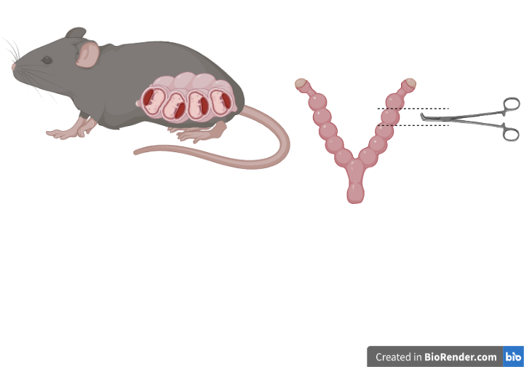
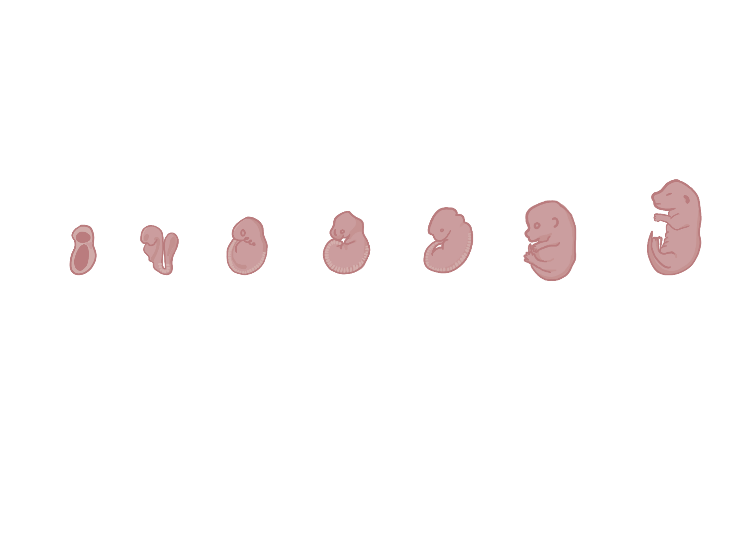

Dataset
E.7.5 Embrionic Day 7.5
<a href="https://www.flaticon.com/de/kostenlose-icons/blutschlauch" title="blutschlauch Icons">Blutschlauch Icons erstellt von Vector Squad - Flaticon</a>
Created with BioRender.com

Slide 10
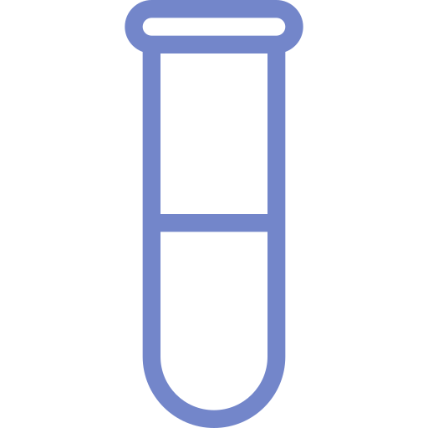
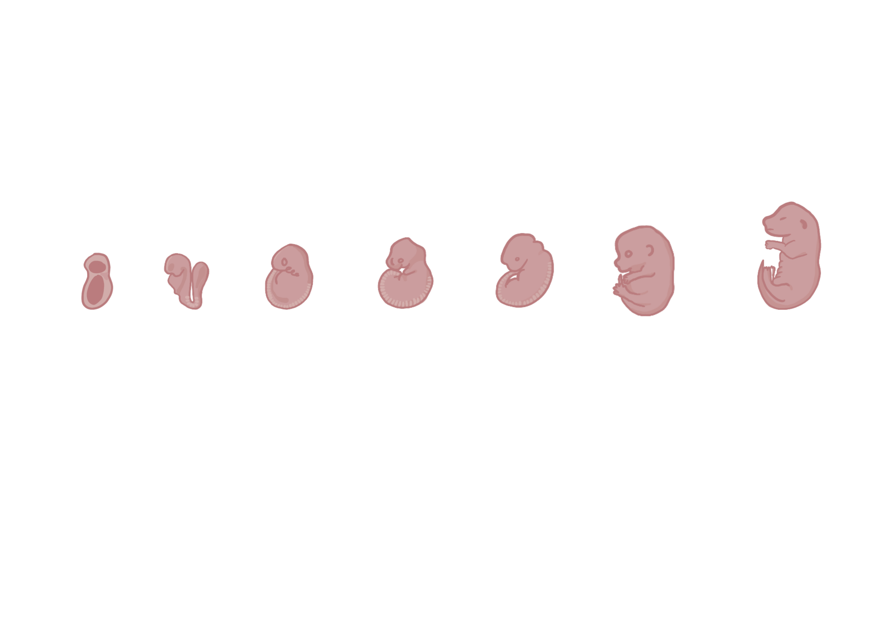

Dataset
RNA
E.7.5 Embrionic Day 7.5
<a href="https://www.flaticon.com/de/kostenlose-icons/blutschlauch" title="blutschlauch Icons">Blutschlauch Icons erstellt von Vector Squad - Flaticon</a>
Created with BioRender.com

Slide 11

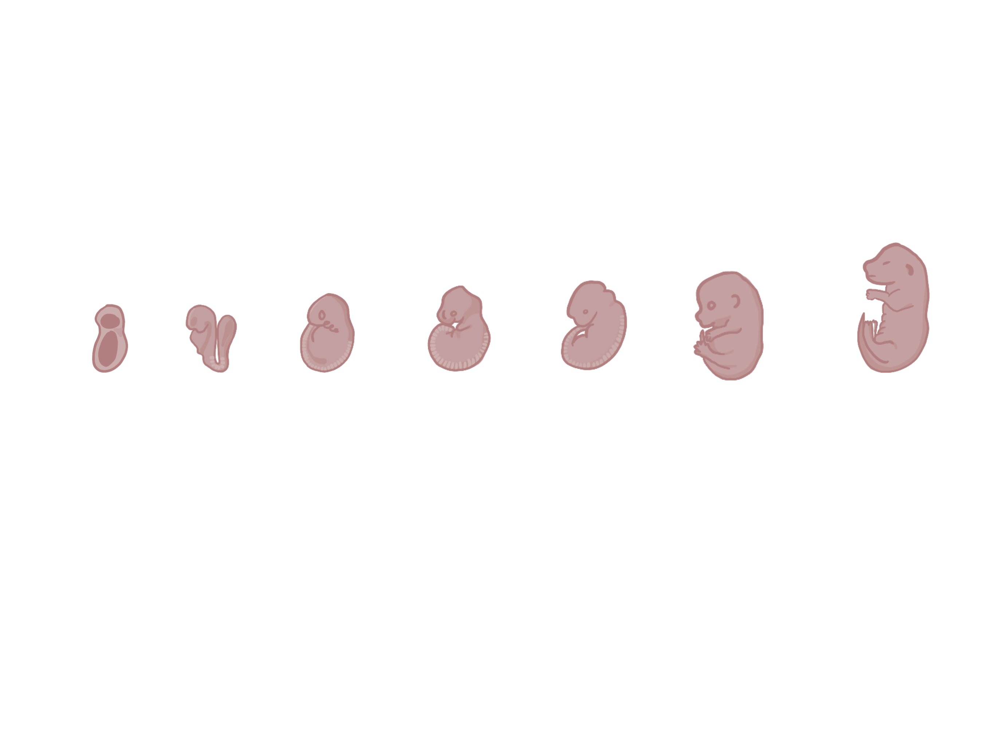

Dataset
Embryo (E7.5 – E18.5)
Mouse Genome 430 2.0 Array
C57BL/6 Mouse
RNA
E.7.5 Embrionic Day 7.5
<a href="https://www.flaticon.com/de/kostenlose-icons/blutschlauch" title="blutschlauch Icons">Blutschlauch Icons erstellt von Vector Squad - Flaticon</a>
Created with BioRender.com
Notes:
? Wie ist dieser Micro Array aufgebaut?
? Was wurde wohin pipettiert (1 Maus auf 1 Array? 1 Maus in 1 Well?) Mice usually bear 6-8 pups during pregnancy. For representation (?) only one was extracted per mouse.
To examine the transcriptome of the mouse embryo, the extracted embryo was homogenized and RNA was extracted for microarray analysis. (The mouse model was C57BL/6 and the specific microarray was Affymetrix Mouse Genome 430 2.0 Array) (For each stage 2 or 3 embryos were extracted for biological replication)

Slide 12
Chemokines
Cytokines
Chemokines
Interferons
Interleucins
Tumor Necrosis Factors
Notes:
Datensatz kurz

Slide 13
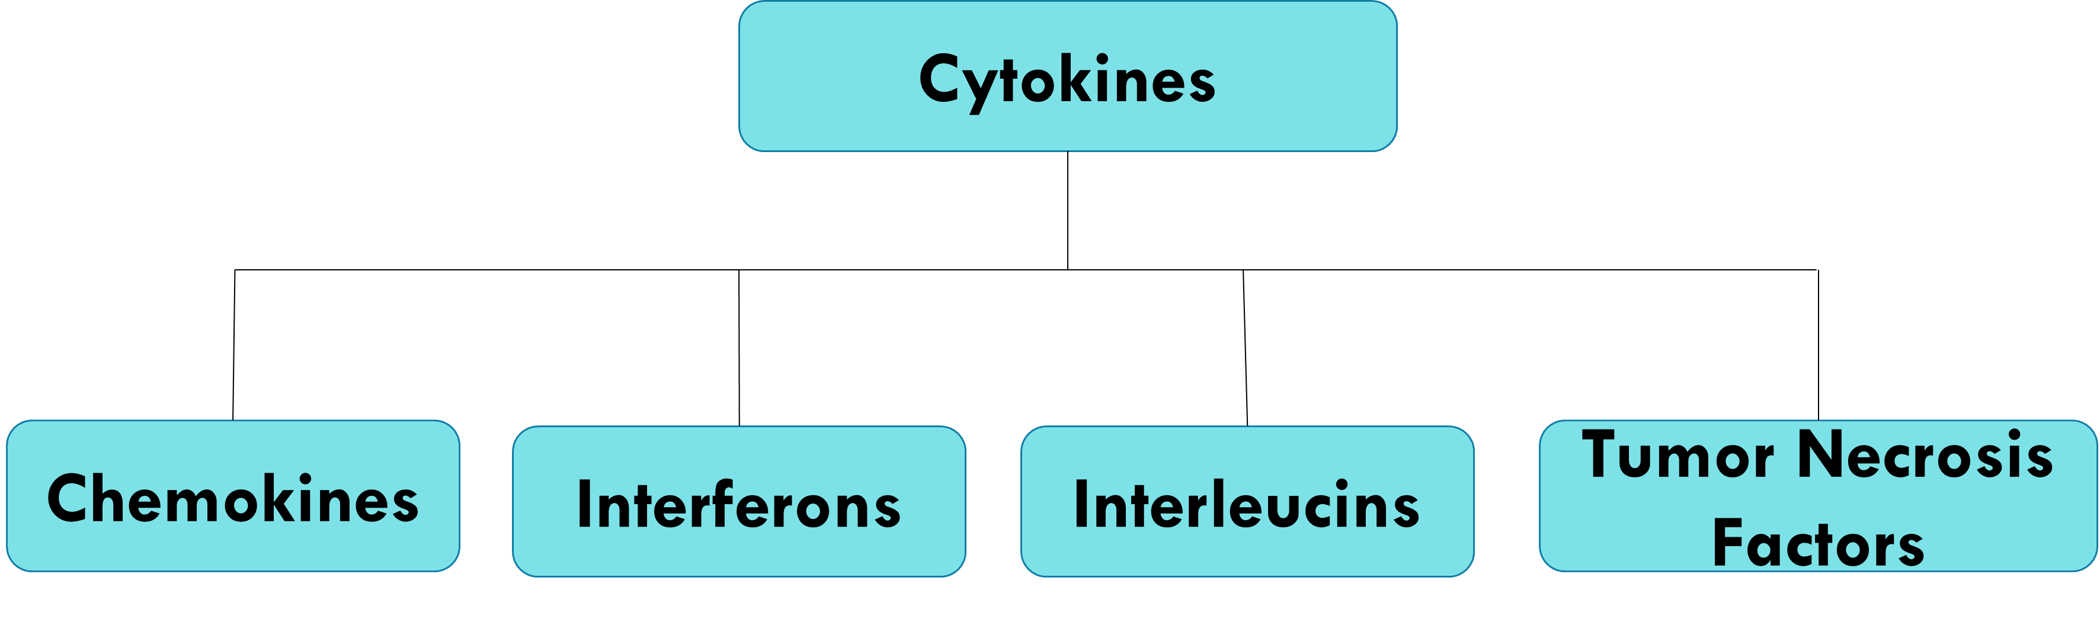
Chemokines
CCL
CXC
Notes:
Chemokines are a subset of signaling molecules, which can also be called cytokines. While cytokines describe signaling molecules in general, chemokines describe signaling molecules that guide a cell in a specific direction, also reffered to as chemotaxis. This is majorly observed in immune response, but also occurs during embryogenesis during cell migration. There are two major families of chemokines, the CC family and the CXC family. You will find abbreviations such as CCL and CCR, the L stands for ligand, this means CCL is a chemokine. R stands for receptor, this means this protein is a receptor for either CC or CXC chemokine. As for CC chemokines, they tend to induce migration of lympohhcytes and monocytes.CCL2 for example promotes Th2 immunity and release of histamine.
Then there are CXC chemokines. These tend to promote neutrophil migration and they include the following: - CXCL8 (IL-8) for recruitment to infected tissue - CXCL12 for migration of germ cells.

Slide 14
Paper vorstellen/Biologischer Background

Slide 15
Verknüpfung von Datenset und Biologie
Was sagt der Datensatz? Welche Zeilen? Was bedeuten die Zahlen etc?

Slide 16
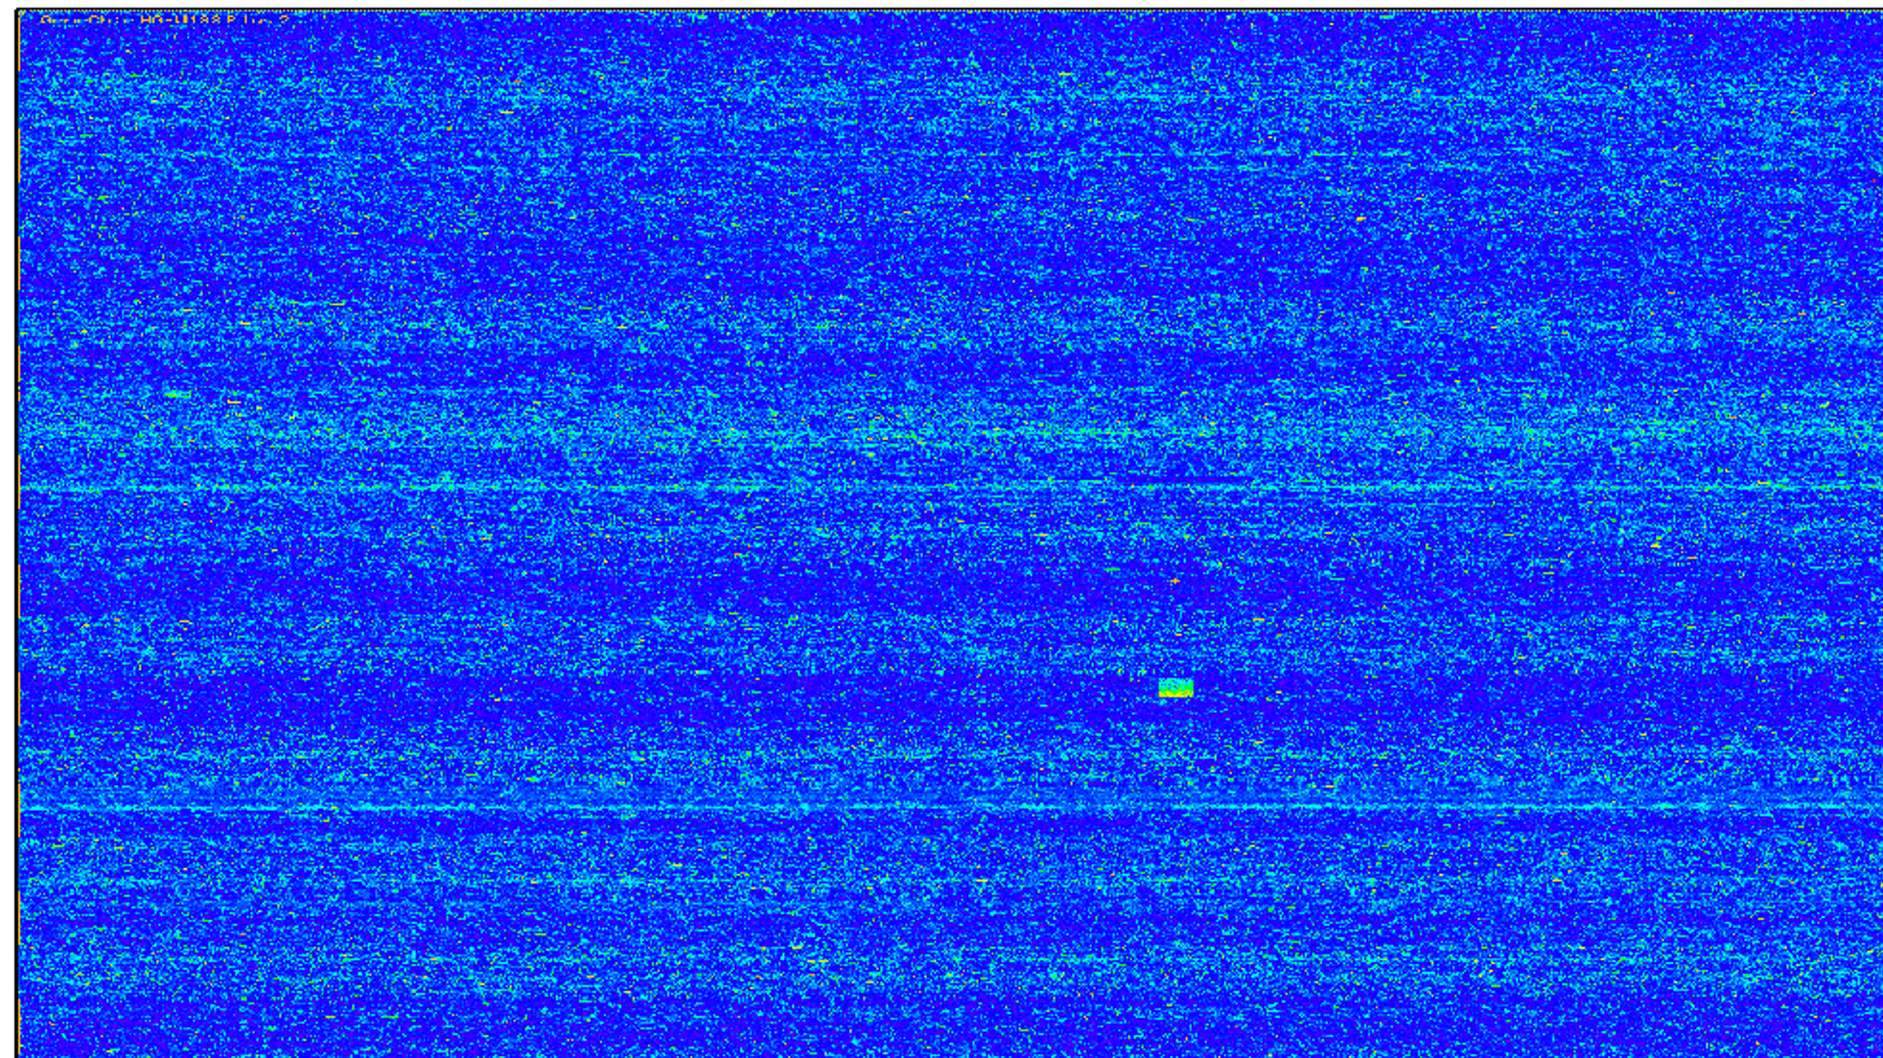
Microarrays
Gene Chip that reads gene expression in form of RNA
RNA -> cDNA -> labelling -> Hybridisation -> Scanning -> Data Acquisition
Labelling via biotin or Fluorescence
Brand of chip: Affymetrix Mouse Genome 430 2.0 Array
Internal Quality Control

Slide 17
Early organ development in mouse embryo

Slide 18
Methods
RNA degradation plot for quality control
VSNrma Normalisation
Boxplot before and after normalisation
If necessary Quantile normalisation
Scatter plot to control chip quality

Slide 19
Clean Data: Correctly assign gene names to Microarray dataset
New table with genes of low variance removed

Slide 20
Chipwise Quality Control
Maybe, we can try this out for a few chips and include some examples
Single cell control

Slide 21
“Hypothese”
How does the differential expression levels change over time of organogenesis in mice?
How does this data correlates with the known TRA-data?
Can we analyse Datensatz in Hinsicht auf den Chemokines
Whether there is a correlation with Chemokines or TRA?
E.g. how to combine with Chemokines, TRA?

Slide 22
Exploratory Dataanalysis
Histogramme
Density plots

Slide 23
What have we done until now?
Here we are
Week 1
Week 2-3
Week 4-6
Week 7-8
13.07. 2022
Data Camp
Github
Organization
Data Exploration
Quality Control
PCA, heatmaps
k-means
differential gene expression
Compare to literature
Bug Fixes
Finish presentation and report
Presentation
Notes:
Erste Folie: was wir bisher gemacht haben
Zweite folie: was noch kommt und dann spezifischer
Sauber Einteilen!!!!

Slide 24
Spezifizierte milestones
Data Exploration: xy
Bioanatytics:
PCA, heatmaps
k-means
differential gene expression
Compare to literature

Slide 25
Timeline
Week 1
Week 2-3
Week 4-6
Week 7-8
13.07. 2022
Data Camp
Github
Organization
Data Exploration
Quality Control
PCA, heatmaps
k-means
differential gene expression
Compare to literature
Bug Fixes
Finish presentation and report
Presentation

Slide 26
References

